Slide 1
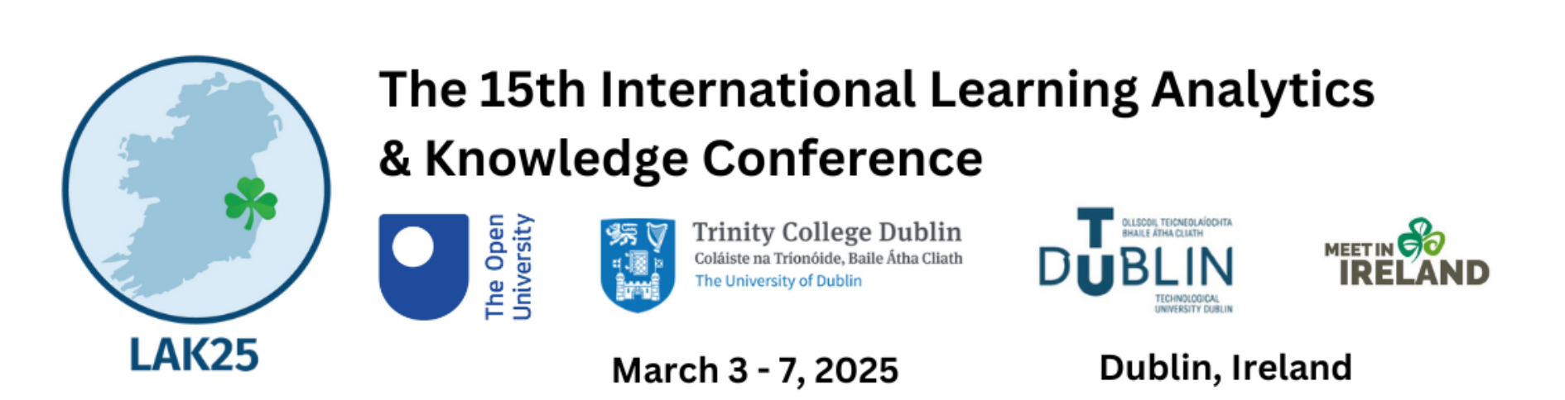


Can synthetic data be fair and private? A compressive study of synthetic data generation and fairness algorithms
6th March, 2025
Qinyi Liu

Slide 2





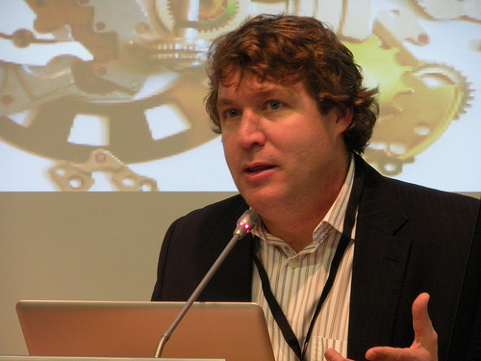
Team introduction
Qinyi Liu
University of Bergen
Oscar Deho
University of South Australia
Farhad Vadiee
University of Bergen
Mohammad Khalil
University of Bergen
Srecko Joksimovic
University of South Australia
George Siemens
University of South Australia

Slide 3

Background
Machine learning models have been widely applied in learning analytics
Fairness and privacy issues are always present in machine learning. When applied ML to LA, fairness and privacy issues still exist.
Less female students sample in dataset, then the model trained on this biased dataset is not fair to female students

Slide 4

Background
Machine learning models have been widely applied in learning analytics
Fairness and privacy issues are always present in machine learning. When applied ML to LA, fairness and privacy issues still exist.
Data leakage: Attackers use technical means to obtain sensitive information in training data.
Model stealing attack: Attackers obtain the parameters or structure of the model by querying it, which may be used for illegal purposes.

Slide 5
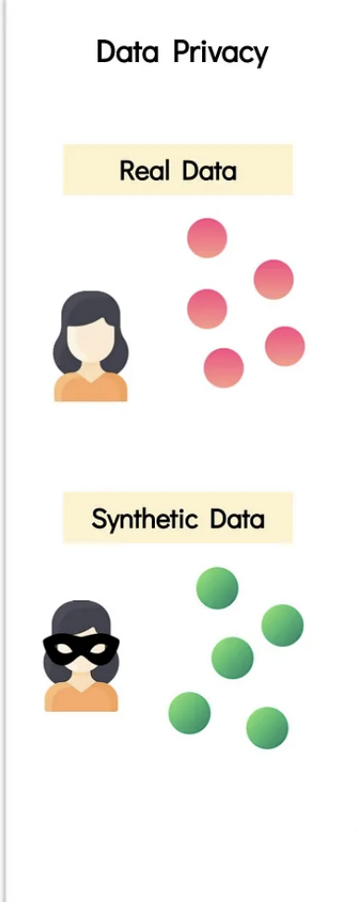
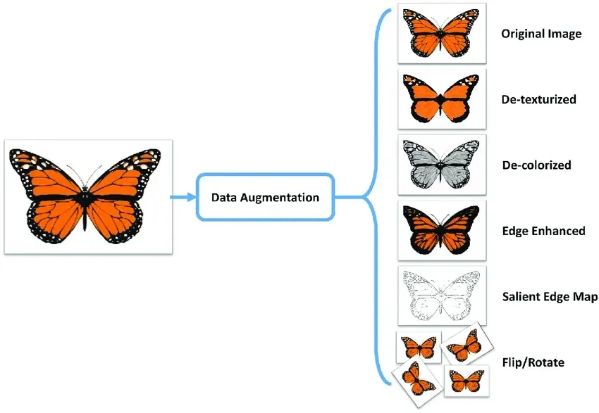
Background
Machine learning models have been widely applied in learning analytics
Fairness and privacy issues are always present in machine learning. When applied ML to LA, fairness and privacy issues still exist.
Synthetic data can use both as privacy-preserving methods and fairness improvement methods.
SDGs has many different categories: fairness-focused, privacy-driven, general data utility use
Synthetic data as fairness improvement
Synthetic data as privacy preserving

Slide 6
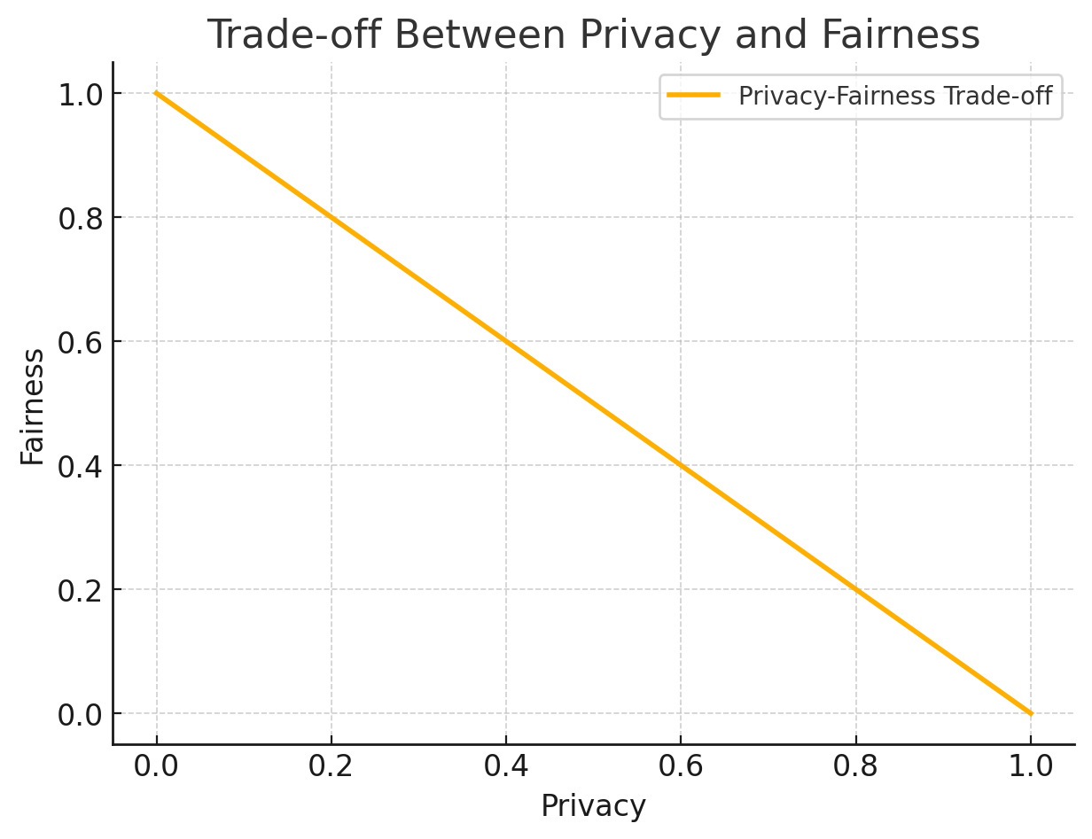
Background
Machine learning models have been widely applied in learning analytics
Fairness and privacy issues are always present in machine learning. When applied ML to LA, fairness and privacy issues still exist.
Synthetic data can use both as privacy-preserving methods and fairness improvement methods.
But the relationship between privacy and fairness is not entirely positively
Relationship between privacy and fairness is trade off in machine learning

Slide 7
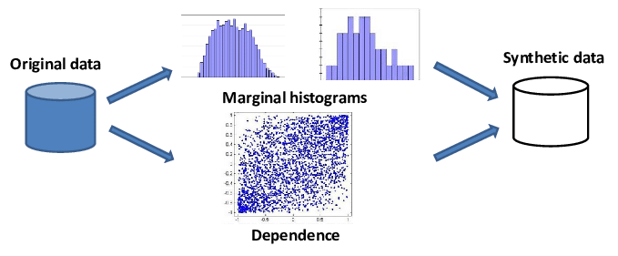
Gaps and motivation 1
The previous research has primarily on studying which SDG balanced well in terms of privacy and utility / focused on studying which SDGs balance well in utility and fairness.
There is a lack of studies examining the trade-offs between privacy and fairness across a broader range of SDGs, including privacy-preserving SDGs, fairness-focused SDGs, and general SDGs.
We also include tabular large language models in the comparing, as LLM traditionally be seen not good at tabular data
Synthetic data generators (SDG)

Slide 8
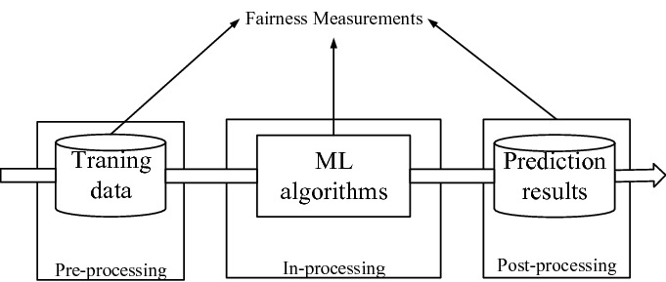

Gaps and motivation 2
Prior research on improving fairness in synthetic data has predominantly applied fairness constraints during the data generation process
Few studies have explored the use of pre-processing fairness algorithms with SDGs
But pre-processing fairness algorithms have demonstrated good performance on real data
We wonder: How about apply pre-processing methods in synthetic data?
Fairness algorithms

Slide 9
Research questions
RQ1. Which synthetic data generator performs best in terms of balancing both privacy and fairness?
RQ2. How can we improve the fairness of synthetic datasets with pre-processing fairness algorithms?

Slide 10
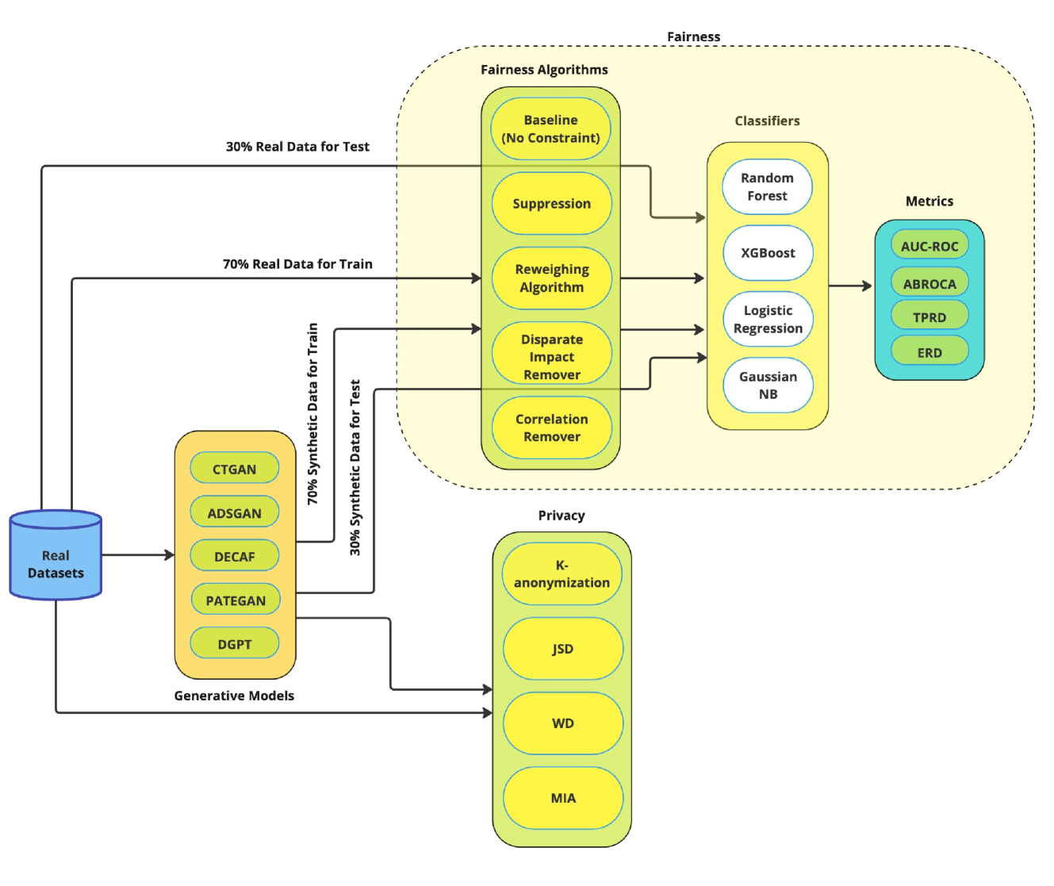
Experiment pipeline

Slide 11
Experiment - data
Student math performance dataset from UCI
Open University Learning Analytics dataset (OULAD)
Law dataset is the longitudinal bar passage data, provided by The Law School Admission Council (LSAC) National Longitudinal Study

Slide 12
Experiment pipeline

Slide 13
Experiment - SDGs
CTGAN – showing good utility performance in tabular data
DistilGPT2 (DGPT) - Large Language model, which is pre-trained with the smallest version of GPT2
ADSGAN - introduces a regularization term during training, thus lowering the risk of privacy attacks such as membership inference
PATEGAN - combines the PATE framework with GANs to generate high-quality synthetic data with differential privacy guarantees
DECAF is a GAN-based model specifically designed to generate fair synthetic data for tabular datasets.
General SDGs
Privacy-preserving SDGs
Fairness-motivated SDGs

Slide 14
Experiment – to answer RQ1
Used 5 SDGs, recommended default parameters in Synthcity
Privacy: The privacy evaluation was repeated twice, and average values were taken to minimize the effect of randomness
Fairness: training the baseline models on the real and synthetic datasets and evaluated them using the fairness metrics.
RQ1. Which synthetic data generator performs best in terms of balancing both privacy and fairness?

Slide 15
Experiment pipeline
For fairness related experiment, We train all the models on 70% of each of the datasets—both real and all synthetic datasets.
During testing, we test all the models on the 30% test set of the real data only.
Allows us to hold all the models to the same standard, ensuring objective and fair comparison.

Slide 16
Experiment – to answer RQ2
Applied each of the 4 pre-processing techniques (i.e., SUP, CoR, DIR, and RW) to debias each of the 70% training datasets
After debiasing all the training datasets, we performed all experiments again in the same manner as we did in the RQ1.
Everything including model training and evaluation remains the same. The only thing that changes is that this time around, the training data is debiased.
RQ2. How can we improve the fairness of synthetic datasets with pre-processing fairness algorithms?

Slide 17
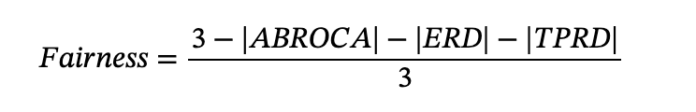
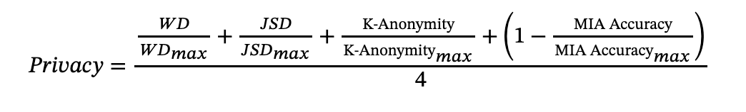
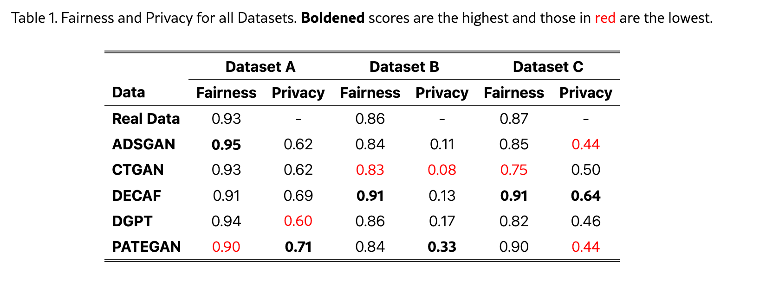
Results – RQ1 Privacy vs. fairness among SDGs
1) Step 1
Processed the metrics to better compare
2) Step 2
DECAF is best performer in terms of balancing privacy and fairness

Slide 18
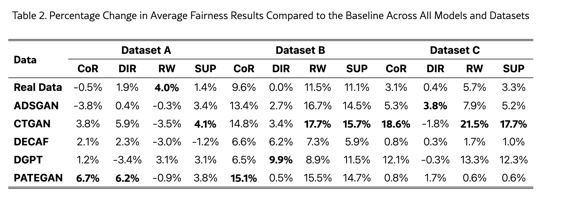
Results – RQ2 Fairness algorithms to improve fairness of synthetic data
SDGs tend to enjoy significant improvement in fairness after the fairness algorithms were applied, especially CTGAN
the effectiveness of different fairness algorithms on the synthetic datasets is not consistent
It is evident that fairness algorithms tend to enhance fairness more effectively on synthetic datasets compared to real datasets
Reasons: SDG itself may inherently address some fairness concerns, functioning similarly to a fairness algorithm

Slide 19
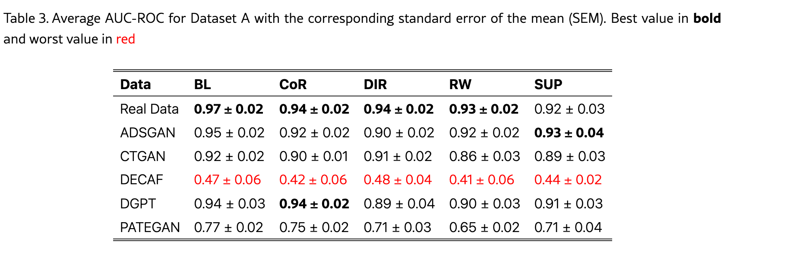
Discussion and conclusion
First, for RQ1, we found that DECAF strikes the best balance between privacy and fairness. However, the best balance achieved by DECAF in terms of privacy and fairness is accompanied by its worst performance in utility.
The utility performance of DECAF is the lowest!

Slide 20
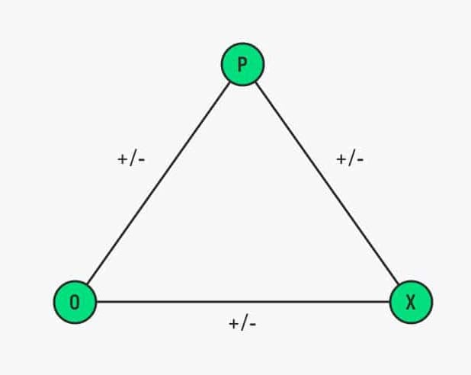
Discussion and conclusion
First, for RQ1, we found that DECAF strikes the best balance between privacy and fairness. However, the best balance achieved by DECAF in terms of privacy and fairness is accompanied by its worst performance in utility.
Implication: 1) Choose based on your application scenario! 2) call for development of SDGs that can perform well in triangular relationship: fairness, privacy and utility
Privacy
Utility
Fairness
In the triangular relationship, one dimension has always been sacrificed

Slide 21
Discussion and conclusion
For RQ2, applying pre-processing fairness algorithms before generating synthetic data can improve the fairness of the synthetic data.
Implication:
Provides a pathway for improving current fair synthetic data generation research but also points to future directions for fairness research.
By optimizing the combination of pre-processing fairness algorithms and synthetic data generation algorithms, fairness can be better ensured, more fairer LA model can be create.

Slide 22



Thank you for listening! Questions? Contact me: qinyi.liu@uib.no
Link to the paper
Connect with me!

